Slide 1
CRYPTOGRAPHY AND NETWORK SECUTITY
Prof.POORNIMA R D
ASSISTANT PROFESSOR
DEPARTMENT OF CSE
DR AIT

Slide 2

TABLE OF CONTENTS
Computer security concepts
The OSI Security Architecture
Security Attacks
Security Services
Security Mechanism
A Model for network security

Slide 3
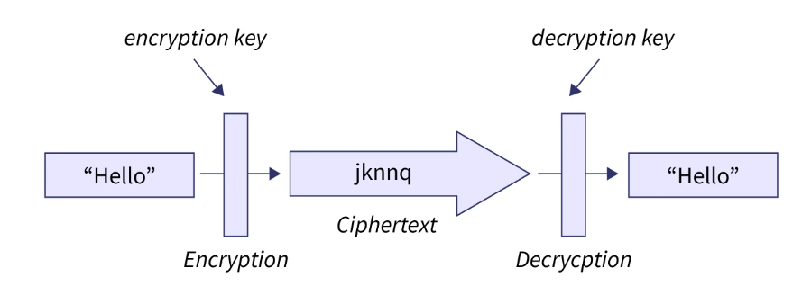
CRYPTOGRAPHY
Cryptography is the process of hiding or coding information so that only the person a message was intended for can read it.
The art of cryptography has been used to code messages for thousands of years and continues to be used in bank cards, computer passwords, and ecommerce.

Slide 4
NETWORK SECURITY
Network security refers to the technologies, policies, people, and procedures that defend any communication infrastructure from cyberattacks, unauthorized access, and data loss.
In addition to the network itself, they also secure traffic and network-accessible assets at both the network edge and inside the perimeter.

Slide 5
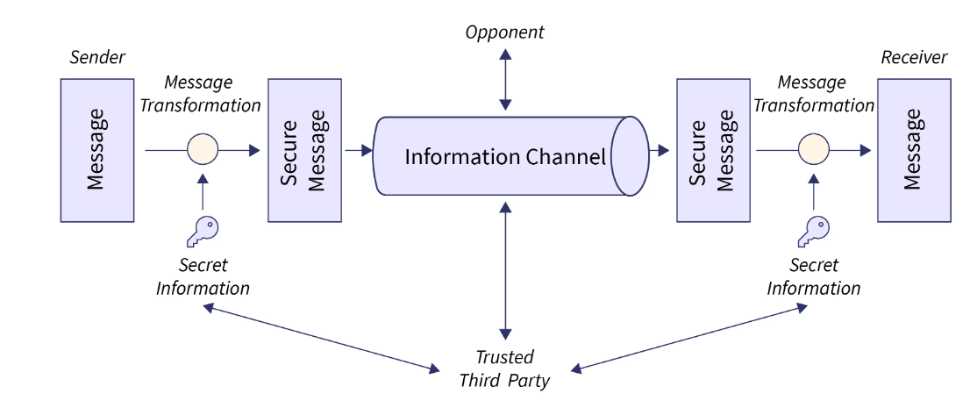

Slide 6
IMPORTANCE OF CRYPTOGRAPHY
For secure communication, data transmission, and transactions.
To safeguard personal information
To ensure data confidentiality
For the protection of data from unauthorized access.
To authenticate the source of data
To establish trust between two communicating parties.

Slide 7
APPLICATIONS OF CRYPTOGRAPHY
Authentication/Digital Signatures
Time Stamping
Electronic Money
Encryption/Decryption in email
WhatsApp Encryption
Instagram Encryption
Sim card Authentication

Slide 8
APPLICATIONS OF NETWORK SECURITY
Protection of network.
Protection from intrusions.
To protect from threats.
Protection of data from breaches.

Slide 9
CRYPTOGRAPHIC PROTOCOLS
Cryptographic algorithms and protocols can be grouped into four main areas:
Symmetric encryption: Used to conceal the contents of blocks or streams of data of any size, including messages, files, encryption keys, and passwords.
Asymmetric encryption: Used to conceal small blocks of data, such as encryption keys and hash function values, which are used in digital signatures.
Data integrity algorithms: Used to protect blocks of data, such as messages, from alteration.
Authentication protocols: These are schemes based on the use of cryptographic algorithms designed to authenticate the identity of entities.

Slide 10
COMPUTER SECURITY CONCEPTS
Computer Security: The protection afforded to an automated information system in order to attain the applicable objectives of preserving the integrity, availability, and confidentiality of information system resources (includes hardware, software, firmware, information/data, and telecommunications).
This definition introduces three key objectives that are at the heart of computer security: ■ Confidentiality: This term covers two related concepts:
Data1 confidentiality: Assures that private or confidential information is not made available or disclosed to unauthorized individuals.
Privacy: Assures that individuals control or influence what information related to them may be collected and stored and by whom and to whom that information may be disclosed.

Slide 11
COMPUTER SECURITY CONCEPTS
Integrity: This term covers two related concepts:
Data integrity: Assures that information (both stored and in transmitted packets) and programs are changed only in a specified and authorized manner.
System integrity: Assures that a system performs its intended function in an unimpaired manner, free from deliberate or inadvertent unauthorized manipulation of the system.
Availability: Assures that systems work promptly and service is not denied to authorized users.

Slide 12
COMPUTER SECURITY CONCEPTS
Confidentiality: Preserving authorized restrictions on information access and disclosure, including means for protecting personal privacy and proprietary information. A loss of confidentiality is the unauthorized disclosure of information.
Integrity: Guarding against improper information modification or destruction, including ensuring information nonrepudiation and authenticity. A loss of integrity is the unauthorized modification or destruction of information.
Availability: Ensuring timely and reliable access to and use of information. A loss of availability is the disruption of access to or use of information or an information system.

Slide 13
CIA TRAID
Confidentiality: Preserving authorized restrictions on information access and disclosure, including means for protecting personal privacy and proprietary information. A loss of confidentiality is the unauthorized disclosure of information.
Integrity: Guarding against improper information modification or destruction, including ensuring information nonrepudiation and authenticity. A loss of integrity is the unauthorized modification or destruction of information.
Availability: Ensuring timely and reliable access to and use of information. A loss of availability is the disruption of access to or use of information or an information system.

Slide 14
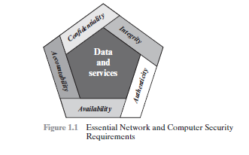
Authenticity: The property of being genuine and being able to be verified and trusted; confidence in the validity of a transmission, a message, or message originator. This means verifying that users are who they say they are and that each input arriving at the system came from a trusted source.
Accountability: The security goal that generates the requirement for actions of an entity to be traced uniquely to that entity. This supports nonrepudiation,deterrence, fault isolation, intrusion detection and prevention, and after action recovery and legal action.

Slide 15
Challenges of Computer Security Challenges of Computer Security
most of the major requirements for security services can be given self-explanatory, one-word labels: confidentiality, authentication, nonrepudiation, or integrity. But the mechanisms used to meet those requirements can be quite complex, and understanding them may involve rather subtle reasoning.
In developing a particular security mechanism or algorithm, one must always consider potential attacks on those security features. In many cases, successful attacks are designed by looking at the problem in a completely different way, therefore exploiting an unexpected weakness in the mechanism.
Because of point 2, the procedures used to provide particular services are often counterintuitive. Typically, a security mechanism is complex, and it is not obvious from the statement of a particular requirement that such elaborate measures are needed. It is only when the various aspects of the threat are considered that elaborate security mechanisms make sense.

Slide 16
Challenges of Computer Security
Having designed various security mechanisms, it is necessary to decide where to use them. This is true both in terms of physical placement (e.g., at what points in a network are certain security mechanisms needed) and in a logical sense (e.g., at what layer or layers of an architecture such as TCP/IP [Transmission Control Protocol/Internet Protocol] should mechanisms be placed).
Security mechanisms typically involve more than a particular algorithm or protocol. They also require that participants be in possession of some secret information (e.g., an encryption key), which raises questions about the creation, distribution, and protection of that secret information. There also may be a reliance on communications protocols whose behavior may complicate the task of developing the security mechanism. For example, if the proper functioning of the security mechanism requires setting time limits on the transit time of a message from sender to receiver, then any protocol or network that introduces variable, unpredictable delays may render such time limits meaningless.
Computer and network security is essentially a battle of wits between a perpetrator who tries to find holes and the designer or administrator who tries to close them. The great advantage that the attacker has is that he or she need only find a single weakness, while the designer must find and eliminate all weaknesses to achieve perfect security.

Slide 17
Challenges of Computer Security
There is a natural tendency on the part of users and system managers to perceive little benefit from security investment until a security failure occurs.
Security requires regular, even constant, monitoring, and this is difficult in today’s short-term, overloaded environment.
Security is still too often an afterthought to be incorporated into a system after the design is complete rather than being an integral part of the design process.

Slide 18
The OSI Security Architecture
The OSI security architecture is useful to managers as a way of organizing the task of providing security. Furthermore, because this architecture was developed as an international standard, computer and communications vendors have developed security features for their products and services that relate to this structured definition of services and mechanisms.
The OSI security architecture focuses on security attacks, mechanisms, and services. These can be defined briefly as:
Security attack: Any action that compromises the security of information owned by an organization.
Security mechanism: A process (or a device incorporating such a process) that is designed to detect, prevent, or recover from a security attack.
Security service: A processing or communication service that enhances the security of the data processing systems and the information transfers of an organization. The services are intended to counter security attacks, and they make use of one or more security mechanisms to provide the service.

Slide 19
Threat
A potential for violation of security, which exists when there is a circumstance, capability, action, or event that could breach security and cause harm. That is, a threat is a possible danger that might exploit a vulnerability.
Attack
An assault on system security that derives from an intelligent threat; that is, an intelligent act that is a deliberate attempt (especially in the sense of a method or technique) to evade security services and violate the security policy of a system.

Slide 20
Security Attacks
Passive attacks (Figure 1.2a) are in the nature of eavesdropping on, or monitoring of, transmissions. The goal of the opponent is to obtain information that is being transmitted.
Two types of passive attacks are the release of message contents and traffic analysis.
The release of message contents is easily understood. A telephone conversation, an electronic mail message, and a transferred file may contain sensitive or confidential information. We would like to prevent an opponent from learning the contents of these transmissions.
A second type of passive attack, traffic analysis, is subtler.
Suppose that we had a way of masking the contents of messages or other information traffic so that opponents, even if they captured the message, could not extract the information from the message. The common technique for masking contents is encryption. If we had encryption protection in place, an opponent might still be able to observe the pattern of these messages. The opponent could determine the location and identity of communicating hosts and could observe the frequency and length of messages being exchanged. This information might be useful in guessing the nature of the communication that was taking place.

Slide 21
Active Attacks
Active Attacks
Active attacks (Figure 1.2b) involve some modification of the data stream or the creation of a false stream and can be subdivided into four categories: masquerade, replay, modification of messages, and denial of service.
A masquerade takes place when one entity pretends to be a different entity (path 2 of Figure 1.2b is active). A masquerade attack usually includes one of the other forms of active attack. For example, authentication sequences can be captured and replayed after a valid authentication sequence has taken place, thus enabling an authorized entity with few privileges to obtain extra privileges by impersonating an entity that has those privileges.
Replay involves the passive capture of a data unit and its subsequent retransmission to produce an unauthorized effect (paths 1, 2, and 3 active).
Modification of messages simply means that some portion of a legitimate message is altered, or that messages are delayed or reordered, to produce an unauthorized effect (paths 1 and 2 active). For example, a message meaning “Allow John Smith to read confidential file accounts” is modified to mean “Allow Fred Brown to read confidential file accounts.”

Slide 22
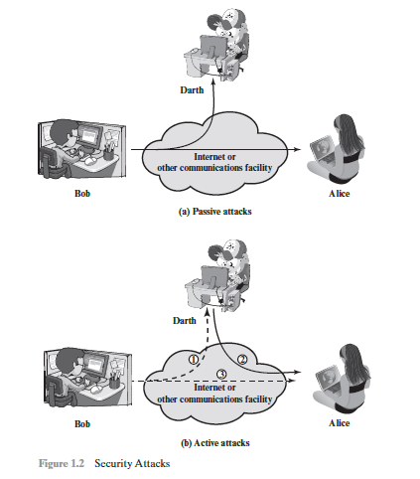

Slide 23
The denial of service prevents or inhibits the normal use or management of communications facilities (path 3 active). This attack may have a specific target; for example, an entity may suppress all messages directed to a particular destination (e.g., the security audit service). Another form of service denial is the disruption of an entire network, either by disabling the network or by overloading it with messages so as to degrade performance.

Slide 24
SECURITY SERVICE
Security Service is a processing or communication service that is provided by a system to give a specific kind of protection to system resources; security services implement security policies and are implemented by security mechanisms.
X.800 divides these services into five categories and fourteen specific services (Table 1.2). We look at each category in turn.5

Slide 25
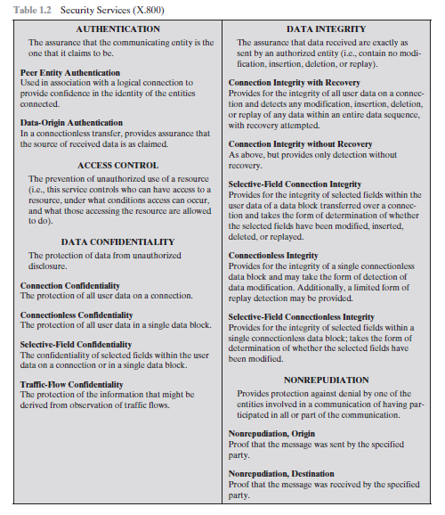
SECURITY SERVICE

Slide 26
SECURITY SERVICE
The authentication service is concerned with assuring that a communication is authentic. In the case of a single message, such as a warning or alarm signal, the function of the authentication service is to assure the recipient that the message is from the source that it claims to be from.
Two specific authentication services are defined in X.800:
Peer entity authentication: Provides for the corroboration of the identity of a peer entity in an association. Two entities are considered peers if they implement to same protocol in different systems.
Data origin authentication: Provides for the corroboration of the source of a data unit. It does not provide protection against the duplication or modification of data units. This type of service supports applications like electronic mail, where there are no prior interactions between the communicating entities.

Slide 27
SECURITY SERVICE
Access Control
In the context of network security, access control is the ability to limit and control the access to host systems and applications via communications links. To achieve this, each entity trying to gain access must first be identified, or authenticated, so that access rights can be tailored to the individual.
Data Confidentiality
Confidentiality is the protection of transmitted data from passive attacks. With respect to the content of a data transmission, several levels of protection can be identified. The broadest service protects all user data transmitted between two users over a period of time.
Data Integrity
As with confidentiality, integrity can apply to a stream of messages, a single message, or selected fields within a message. Again, the most useful and straightforward approach is total stream protection.

Slide 28
SECURITY SERVICE
Nonrepudiation
Nonrepudiation prevents either sender or receiver from denying a transmitted message. Thus, when a message is sent, the receiver can prove that the alleged sender in fact sent the message.
Availability Service
X.800 treats availability as a property to be associated with various security services. However, it makes sense to call out specifically an availability service. An availability service is one that protects a system to ensure its availability. This service addresses the security concerns raised by denial-of-service attacks. It depends on proper management and control of system resources and thus depends on access control service and other security services.

Slide 29
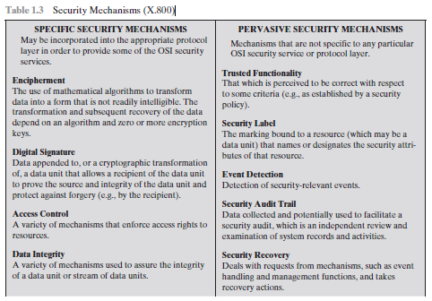
SECURITY MECHANISMS
The mechanisms are divided into those that are implemented in a specific protocol layer, such as TCP or an application-layer protocol, and those that are not specific to any particular protocol layer or security service.

Slide 30
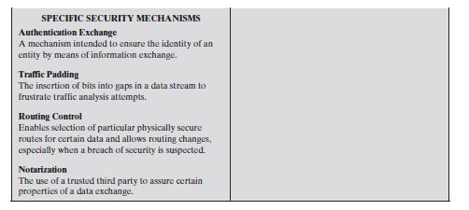
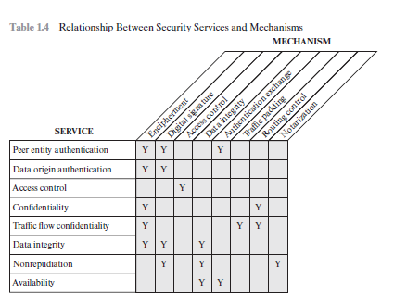
SECURITY MECHANISMS

Slide 31
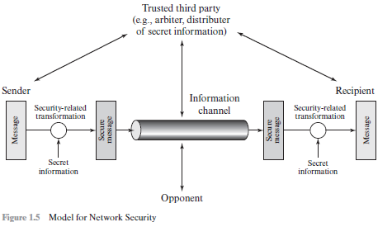
MODEL FOR NETWORK SECURITY
A message is to be transferred from one party to another across some sort of Internet service. The two parties, who are the principals in this transaction, must cooperate for the exchange to take place. A logical information channel is established by defining a route through the Internet from source to destination and by the cooperative use of communication protocols (e.g., TCP/IP) by the two principals.

Slide 32
MODEL FOR NETWORK SECURITY
All the techniques for providing security have two components:
A security-related transformation on the information to be sent. Examples include the encryption of the message, which scrambles the message so that it is unreadable by the opponent, and the addition of a code based on the contents of the message, which can be used to verify the identity of the sender.
Some secret information shared by the two principals and, it is hoped, unknown to the opponent. An example is an encryption key used in conjunction with the transformation to scramble the message before transmission and unscramble it on reception.6

Slide 33
MODEL FOR NETWORK SECURITY
This general model shows that there are four basic tasks in designing a particular security service:
Design an algorithm for performing the security-related transformation. The algorithm should be such that an opponent cannot defeat its purpose.
Generate the secret information to be used with the algorithm.
Develop methods for the distribution and sharing of the secret information.
Specify a protocol to be used by the two principals that makes use of the security algorithm and the secret information to achieve a particular security service.
Programs can present two kinds of threats:
Information access threats: Intercept or modify data on behalf of users who should not have access to that data.
Service threats: Exploit service flaws in computers to inhibit use by legitimate users.

Slide 34
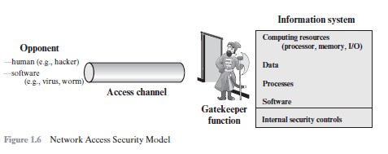
MODEL FOR NETWORK SECURITY

Slide 35
Symmetric Cipher Model
Symmetric encryption, also referred to as conventional encryption or single-key encryption, was the only type of encryption in use prior to the development of public key encryption.
An original message is known as the plaintext, while the coded message is called the ciphertext. The process of converting from plaintext to ciphertext is known as enciphering or encryption; restoring the plaintext from the ciphertext is deciphering or decryption.
The many schemes used for encryption constitute the area of study known as cryptography. Such a scheme is known as a cryptographic system or a cipher. Techniques used for deciphering a message without any knowledge of the enciphering details fall into the area of cryptanalysis. Cryptanalysis is what the layperson calls “breaking the code.” The areas of cryptography and cryptanalysis together are called cryptology.

Slide 36
A symmetric encryption scheme has five ingredients (Figure 3.1):
Plaintext: This is the original intelligible message or data that is fed into the algorithm as input.
Encryption algorithm: The encryption algorithm performs various substitutions and transformations on the plaintext.
Secret key: The secret key is also input to the encryption algorithm. The key is a value independent of the plaintext and of the algorithm. The algorithm will produce a different output depending on the specific key being used at the time. The exact substitutions and transformations performed by the algorithm depend on the key.

Slide 37
There are two requirements for secure use of conventional encryption:
1. We need a strong encryption algorithm. At a minimum, we would like the algorithm to be such that an opponent who knows the algorithm and has access to one or more cipher texts would be unable to decipher the ciphertext or figure out the key. This requirement is usually stated in a stronger form: The opponent should be unable to decrypt ciphertext or discover the key even if he or she is in possession of a number of ciphertexts together with the plaintext that produced each ciphertext.
2. Sender and receiver must have obtained copies of the secret key in a secure fashion and must keep the key secure. If someone can discover the key and knows the algorithm, all communication using this key is readable.

Slide 38
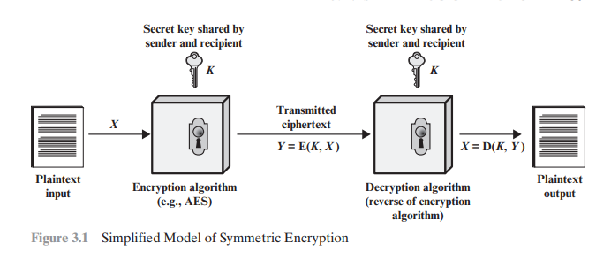

Slide 39
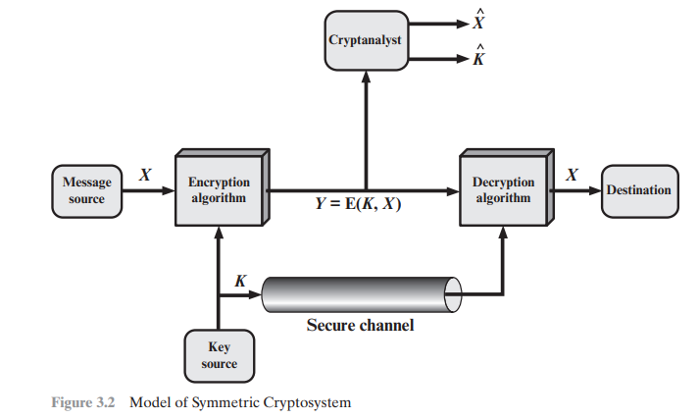

Slide 40
Cryptographic systems are characterized along three independent dimensions:
1. The type of operations used for transforming plaintext to ciphertext. All encryption algorithms are based on two general principles: substitution, in which each element in the plaintext (bit, letter, group of bits or letters) is mapped into another element, and transposition, in which elements in the plaintext are rearranged. The fundamental requirement is that no information be lost (i.e., that all operations are reversible). Most systems, referred to as product systems, involve multiple stages of substitutions and transpositions.
2. The number of keys used. If both sender and receiver use the same key, the system is referred to as symmetric, single-key, secret-key, or conventional encryption. If the sender and receiver use different keys, the system is referred to as asymmetric, two-key, or public-key encryption.
3. The way in which the plaintext is processed. A block cipher processes the input one block of elements at a time, producing an output block for each input block. A stream cipher processes the input elements continuously, producing output one element at a time, as it goes along.

Slide 42
Cryptanalysis and Brute-Force Attack
Typically There are two general approaches to attacking a conventional encryption scheme:
Cryptanalysis: Cryptanalytic attacks rely on the nature of the algorithm plus perhaps some knowledge of the general characteristics of the plaintext or even some sample plaintext–ciphertext pairs. This type of attack exploits the characteristics of the algorithm to attempt to deduce a specific plaintext or to deduce the key being used.
Brute-force attack: The attacker tries every possible key on a piece of ciphertext until an intelligible translation into plaintext is obtained. On average, half of all possible keys must be tried to achieve success

Slide 43
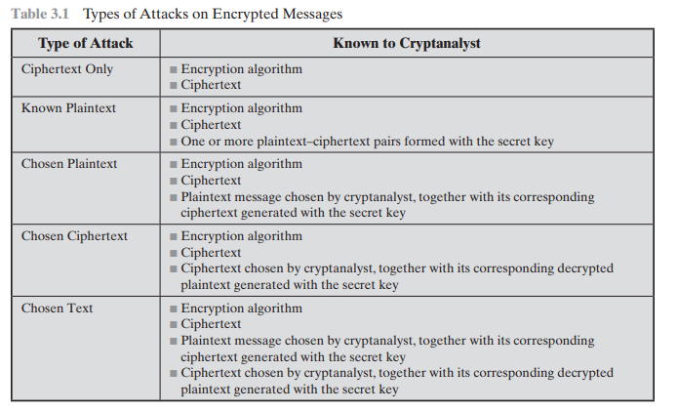

Slide 44
SUBSTITUTION TECHNIQUES
The two basic building blocks of all encryption techniques are substitution and transposition.
A substitution technique is one in which the letters of plaintext are replaced by other letters or by numbers or symbols.1 If the plaintext is viewed as a sequence of bits, then substitution involves replacing plaintext bit patterns with ciphertext bit patterns.
CAESAR CIPHER

Slide 45
CAESAR CIPHER
The earliest known, and the simplest, use of a substitution cipher was by Julius Caesar. The Caesar cipher involves replacing each letter of the alphabet with the letter standing three places further down the alphabet.
For example,
plain: meet me after the toga party
cipher: PHHW PH DIWHU WKH WRJD SDUWB
Note that the alphabet is wrapped around, so that the letter following Z is A. We can define the transformation by listing all possibilities, as follows:
plain: a b c d e f g h i j k l m n o p q r s t u v w x y z
cipher: D E F G H I J K L M N O P Q R S T U V W X Y Z A B C

Slide 46
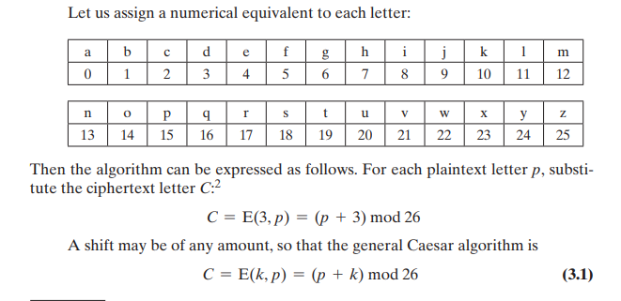

Slide 47
Monoalphabetic Ciphers

Slide 49
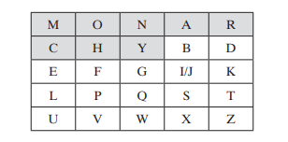
Playfair Cipher
The best-known multiple-letter encryption cipher is the Playfair, which treats diagrams in the plaintext as single units and translates these units into ciphertext digrams.3 The Playfair algorithm is based on the use of a 5 * 5 matrix of letters constructed using a keyword
The letters I and J count as one letter. Plaintext is encrypted two letters at a time, according to the following rules:
Repeating plaintext letters that are in the same pair are separated with a filler letter, such as x, so that balloon would be treated as ba lx lo on.
2. Two plaintext letters that fall in the same row of the matrix are each replaced by the letter to the right, with the first element of the row circularly following the last. For example, ar is encrypted as RM.
Two plaintext letters that fall in the same column are each replaced by the letter beneath, with the top element of the column circularly following the last. For example, mu is encrypted as CM.
Otherwise, each plaintext letter in a pair is replaced by the letter that lies in its own row and the column occupied by the other plaintext letter. Thus, hs becomes BP and ea becomes IM (or JM, as the encipherer wishes).

Slide 50
Transposition Techniques
All the techniques examined so far involve the substitution of a ciphertext symbol for a plaintext symbol. A very different kind of mapping is achieved by performing some sort of permutation on the plaintext letters. This technique is referred to as a transposition cipher.
The simplest such cipher is the rail fence technique, in which the plaintext is written down as a sequence of diagonals and then read off as a sequence of rows.
For example, to encipher the message “meet me after the toga party” with a rail fence of depth 2, we write the following: m e m a t r h t g p r y e t e f e t e o a a t The encrypted message is MEMATRHTGPRYETEFETEOAAT

